Slide 1
Bitcoin EMA Margin trade Strategy
Group 3
Li li
Siqi Yi
Yutao Liang

Slide 2
1
Purpose and main idea
Content
2
Specific methods and steps
3
The final result

Slide 3
PART ONE
Purpose and main idea

Slide 4
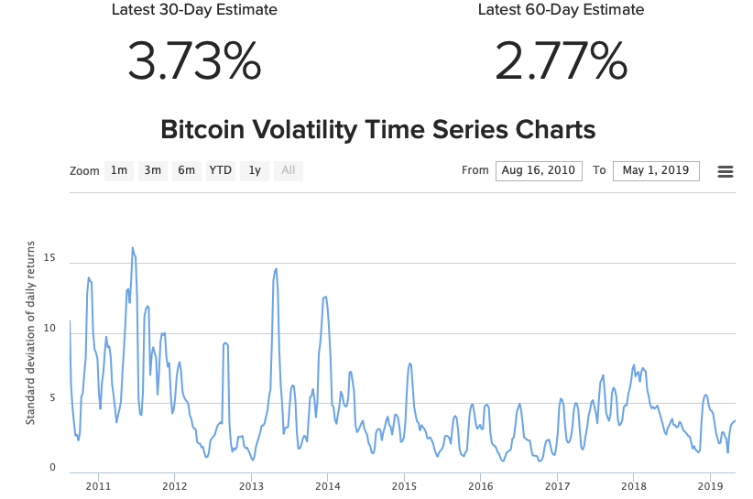
Purpose
01

Slide 5
Purpose
01
Bitcoin‘s price volatility is great.
Returns of time the market are large.
Short at high price, long at low price.

Slide 6
Main idea
01
15%
55%
100%
Simulate trade-related cost
Build up EMA Margin Trade Strategy
Optimise the Strategy and Select the Best Strategy

Slide 7
PART TWO
Specific methods and steps

Slide 8
02
Specific methods and steps
First
We use Volume Weighted Average Price(VWAP) trading strategy to simulate the trade-related cost.
The evaluation indexes include the pecentage of trade-related cost.

Slide 9
02
Specific methods and steps
First
Download BTC market chart and trade history data
Build Polinomial Linear Model with train data
Calculate Trade-related Cost and the pecentage.
Trade with Model
Download Data
Process Data
Build Model
Calculate Cost
Index, fill, split, random select start time. Train and test dataset.
Trade with the Model every minute

Slide 10
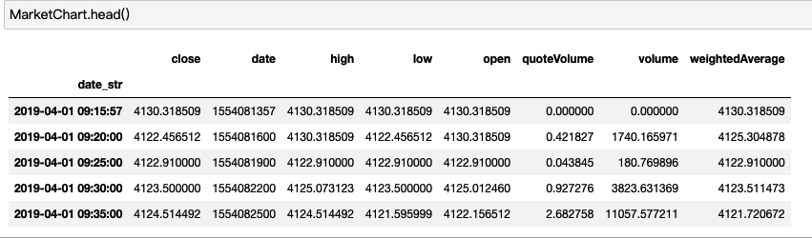
02
Specific methods and steps
Download Data

Slide 11
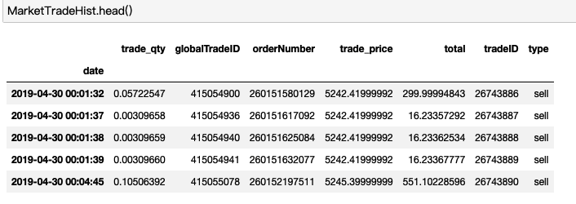
02
Specific methods and steps
Download Data

Slide 12
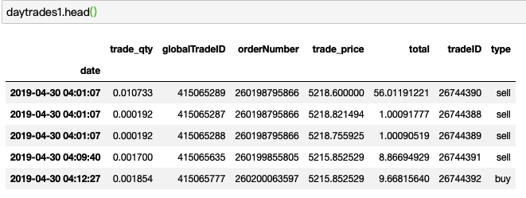
02
Specific methods and steps
Process Data

Slide 13
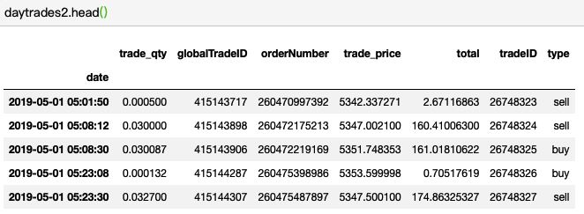
02
Specific methods and steps
Process Data

Slide 14
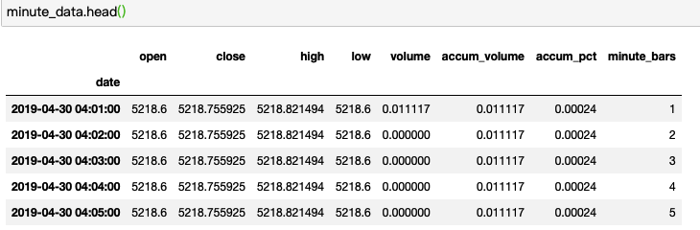
02
Specific methods and steps
Process Data

Slide 15
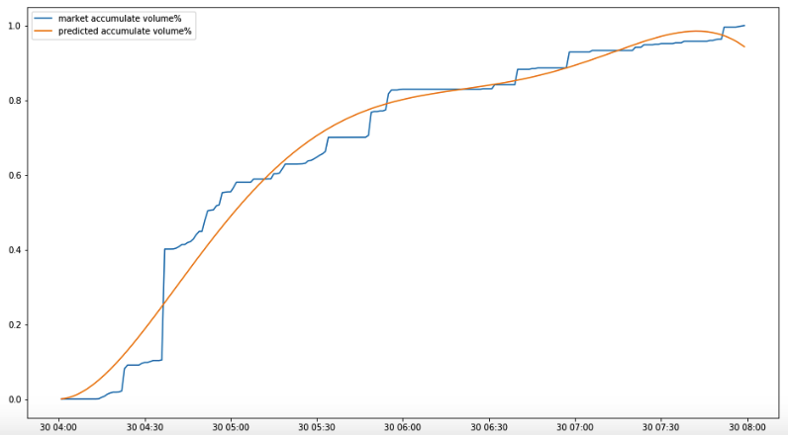
02
Specific methods and steps
Build the Model

Slide 16
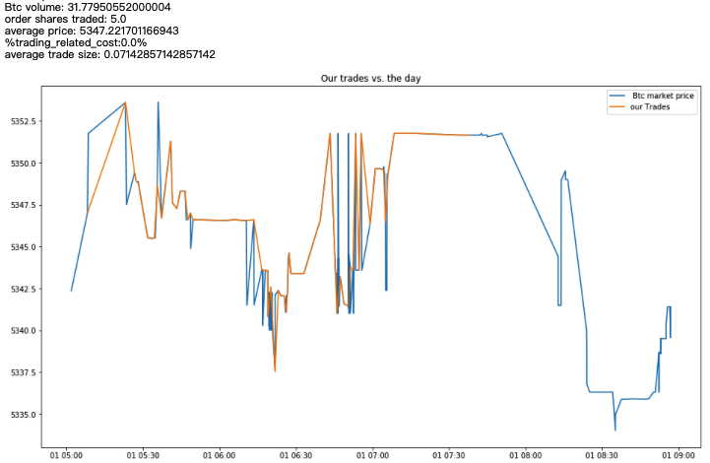
02
Specific methods and steps
Trade with Model

Slide 17
02
Specific methods and steps
Second
Analyse the difference between Bitcoin price and Exponential Moving Average(EMA) price to find the boundary of abnormal high and abnormal low. Short in abnormal high price and long in abnormal low price.
The calculated indices of the model include:
winning rate
monthly return
annual return

Slide 18
02
Specific methods and steps
Second
Long at Long signal, Short at Short signal, Including Trade Cost
Calculate Exponential Moving Average(EMA)
Abnormal is mean +- 3standard deviation
Calculate %Pice vs EMA
Trade with Signan
Calculate EMA
Define Abnormal
Build Signal
Calculate pecentage of Price vs EMA
Long signal at Negtive Abnormal, Short signal at Positive Abnormal

Slide 19
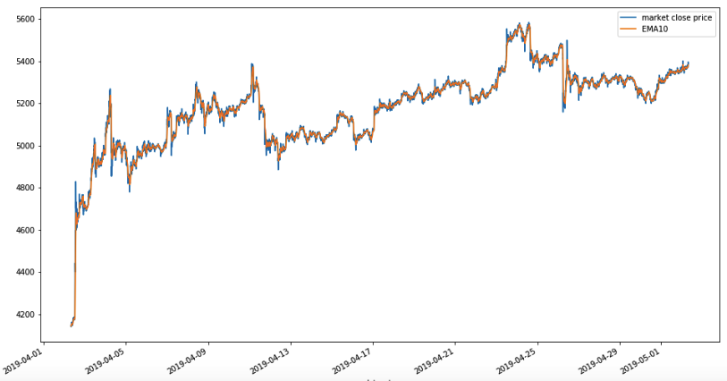
02
Specific methods and steps
Calculate EMA

Slide 20
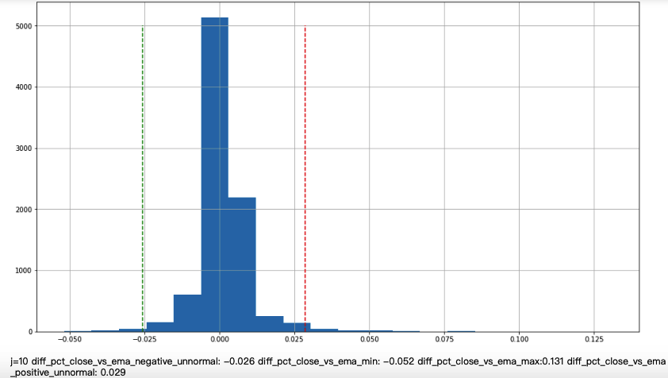
02
Specific methods and steps
Define Abnormal

Slide 21
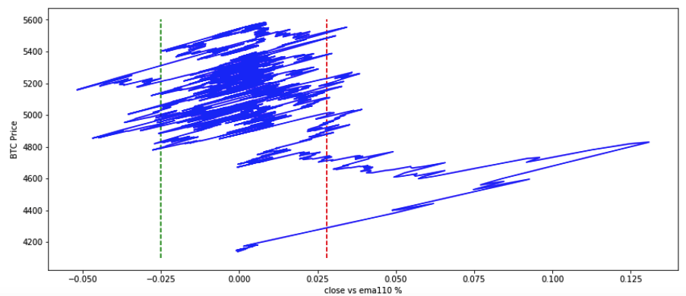
02
Specific methods and steps
Define Abnormal

Slide 22
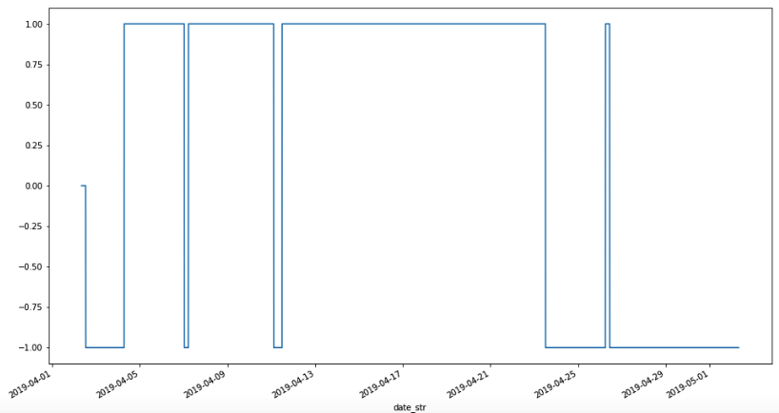
02
Build Signal
Specific methods and steps

Slide 23
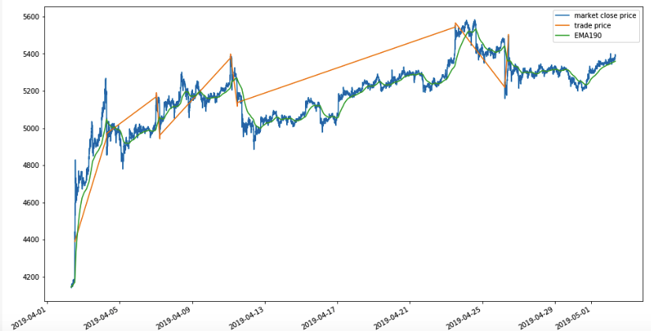
02
Trade with Signan
Specific methods and steps

Slide 24
02
Specific methods and steps
Third
Select multiple span of EMA, execute the strategy many times. Find the optimised stragegy that has the maxmum return and high winning rate.
The evaluation indexes of the model include:
winning rate
monthly return
annual return

Slide 25
02
Specific methods and steps
Third
Select Multiple Span of EMA, Calculate Multiple EMA
Calculate Return and Winning Rate
Execute Strategy with EMAs
Select Multiple Span
Calculate Indices
Find the Best EMA
Execute Strategy with different EMAs
Find the Best EMA with Max Return and high Winning Rate

Slide 26
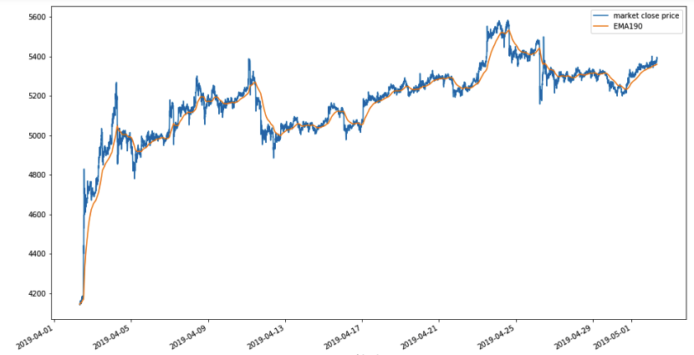
02
Specific methods and steps
Select Multiple Span

Slide 27

02
Specific methods and steps
Find the Best EMA

Slide 28
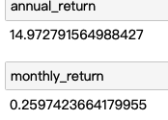
02
Specific methods and steps
Find the Best EMA

Slide 29
PART THREE
The Final Result

Slide 30
03
Final Result
100
Best Span:110
75
Annual return:1500%
50
25
Winning Rate:86%
0
五月份
六月份
七月份

Slide 31
Thanks

